Slide 1

Soil organic matter improving the bioremediation of insensitive munitions compounds
1
Eliot J. Baker
Osmar Menezes, Reyes Sierra-Alvarez, Jim A. Field
Department of Chemical and Environmental Engineering, University of Arizona
Annual Arizona NASA Space Grant 2022 Symposium
Hilton Tucson East April 23rd, 2022
Notes:
Introduce the project, my name and Osmar and research group.

Slide 2
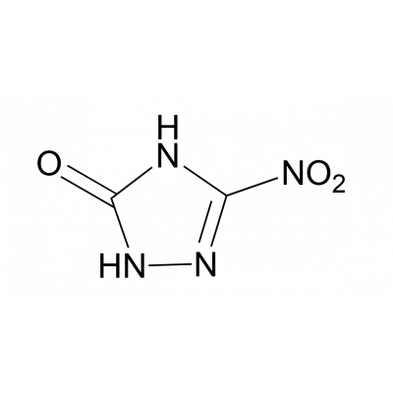
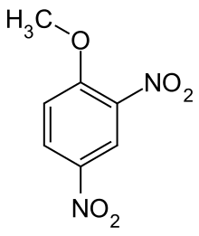
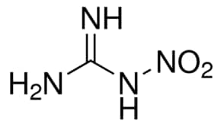


What are insensitive munitions compounds (IMCs)?
2
NTO
3-Nitro-1,2,3-triazol-5-one
DNAN
2,4- Dinitroanisole
Nitroguanidine
Notes:
Introduce what IMCs are and how they are being used by the military because they are much more temperature and shock resistant, point out NO2 groups and how they are hard to degrade.

Slide 3
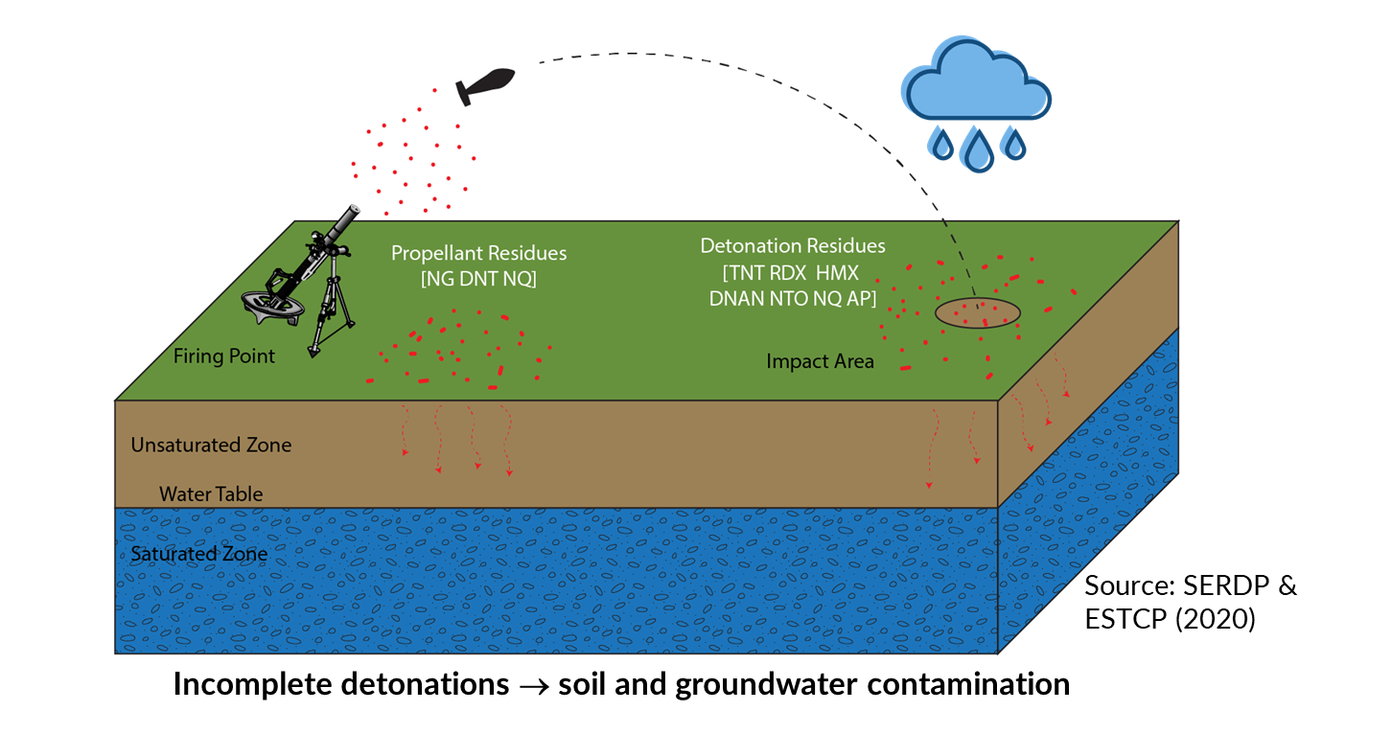
IMC’s in the environment
3
Notes:
Show how nitroaromatics can end up in environment, through diffusion into our saturated soils as well as wash away into our surface water.

Slide 4
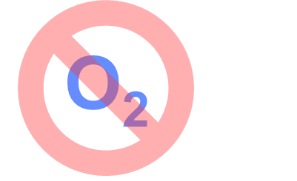
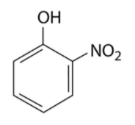


Nitroaromatic reduction in anaerobic environment
4
R
R
$$e^{−}$$
$${NH}_{2}$$
Notes:
Very important first step in getting rid of these contaminants. Reducing Nitro groups to amine groups helps with being able to degrade and treat.

Slide 5
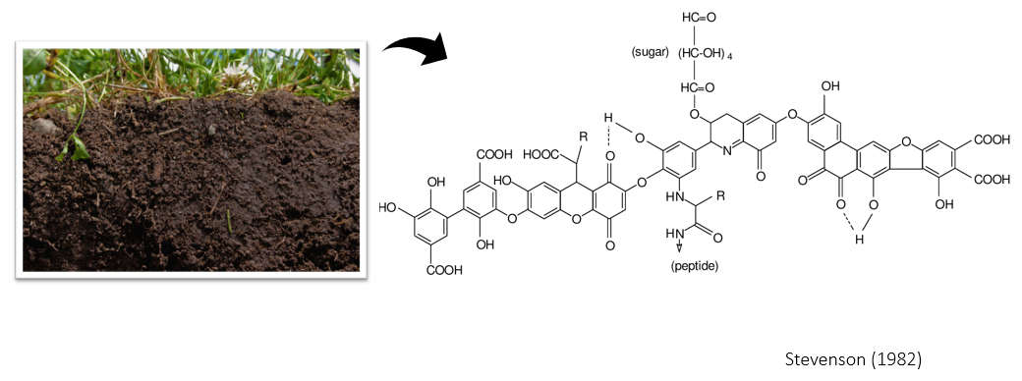
Natural Organic Matter (NOM) contains Quinones
5
Notes:
Show that in the soil there are what are called quinones, 3 benzene rings with double bonded oxygens on a ring.

Slide 6
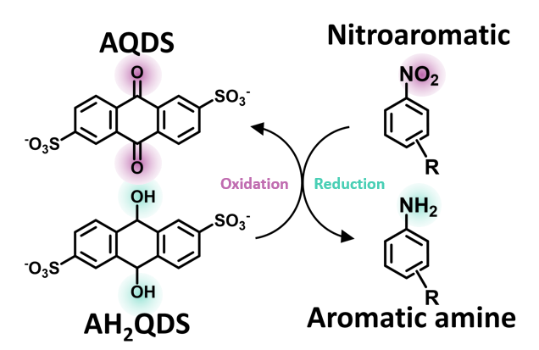
Nitroaromatic reduction via Quinones
6
Notes:
What is special about quinones is that we believed they’d be able to act as a reducing reagent for chemically reducing nitroaromatics to aromatic amines.

Slide 7
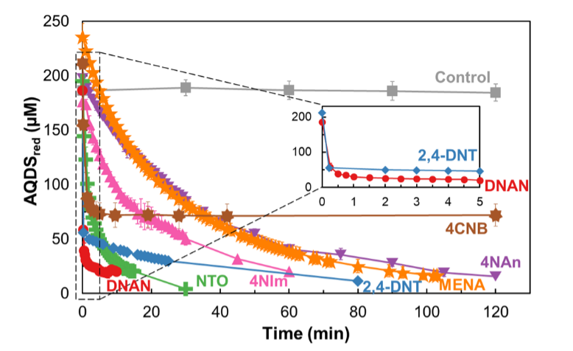
Experimental Oxidation of Quinones (AQDS)
7
Notes:
This is an experiment we performed with multiple nitroaromatics to check the oxidation of the hydroquinone
The reaction occurred from couple minutes to couple hours depending on how strong was the nitrocompound acting as an oxidant

Slide 8
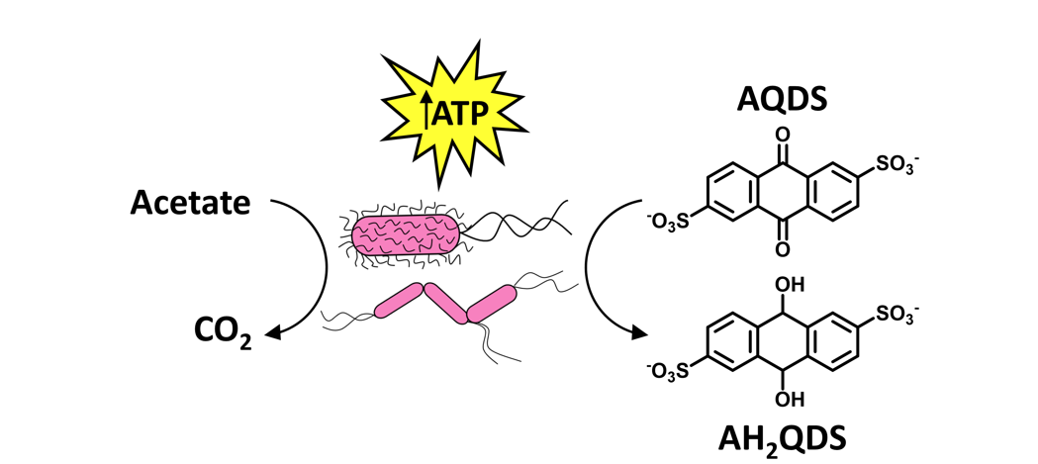
Biotic (biological) reaction necessary
8
Geobacter anodireducens
Notes:
Once confirming that reduced quinones (AHQDS) can reduce nitroaromatics, we needed a bacteria that could continuously reduce AQDS so the nitroaromatic could oxidize the AHQDS and in turn be reduced.

Slide 9
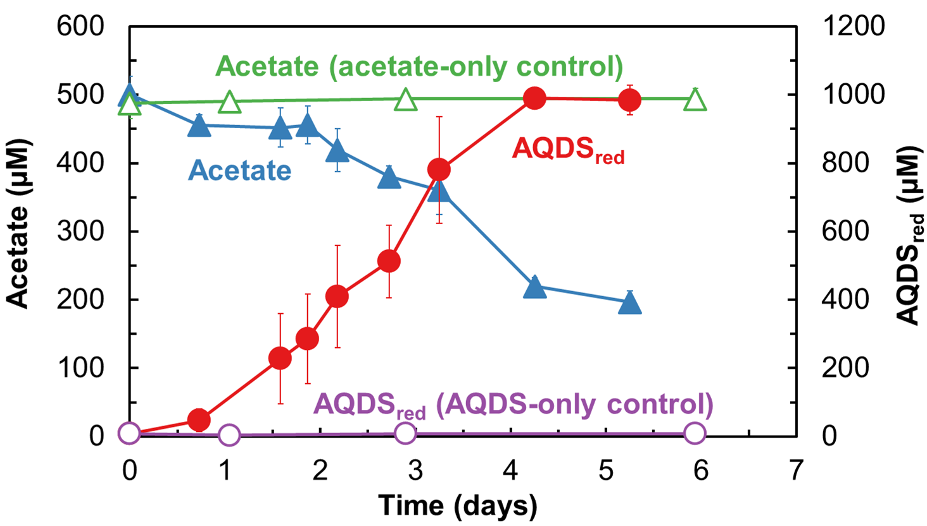
Experimental AQDS reduction
9
Notes:
Experiment proving that this geobacter bacteria could act in oxidizing acetate and reducing AQDS

Slide 10
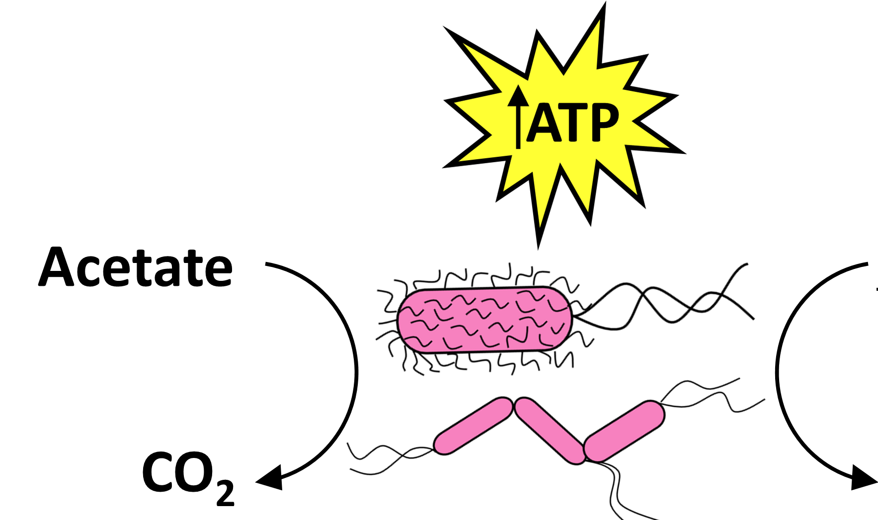
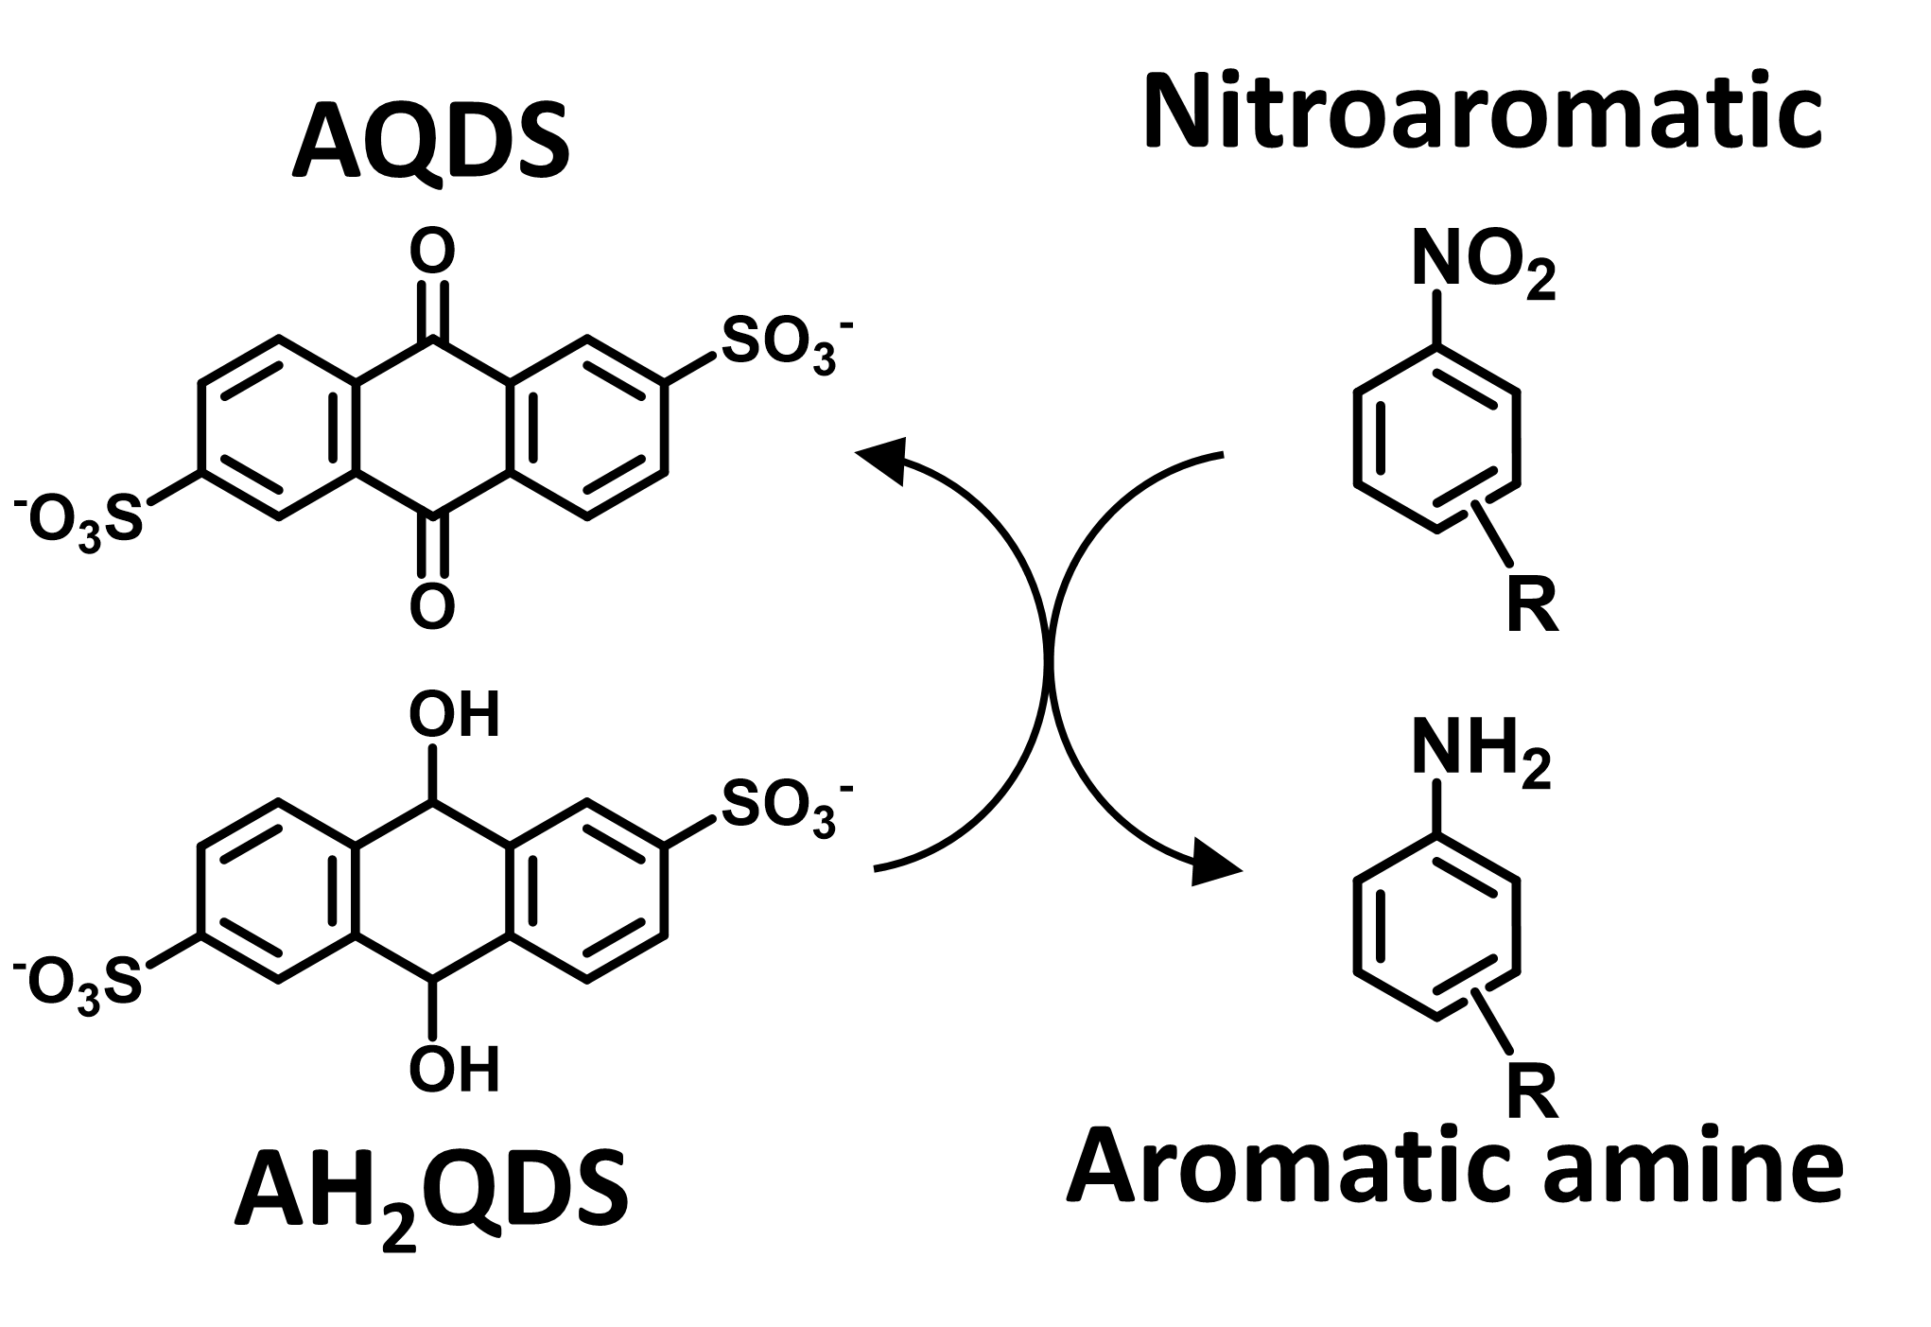
Confirming Total Reduction Process
10
Notes:
- Led us to the final overall process that could occur in nature, the biological and chemical processes coupled
- Quinones constantly being regenerated from reducing the nitroaromatic

Slide 11
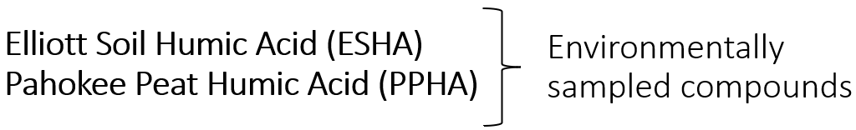
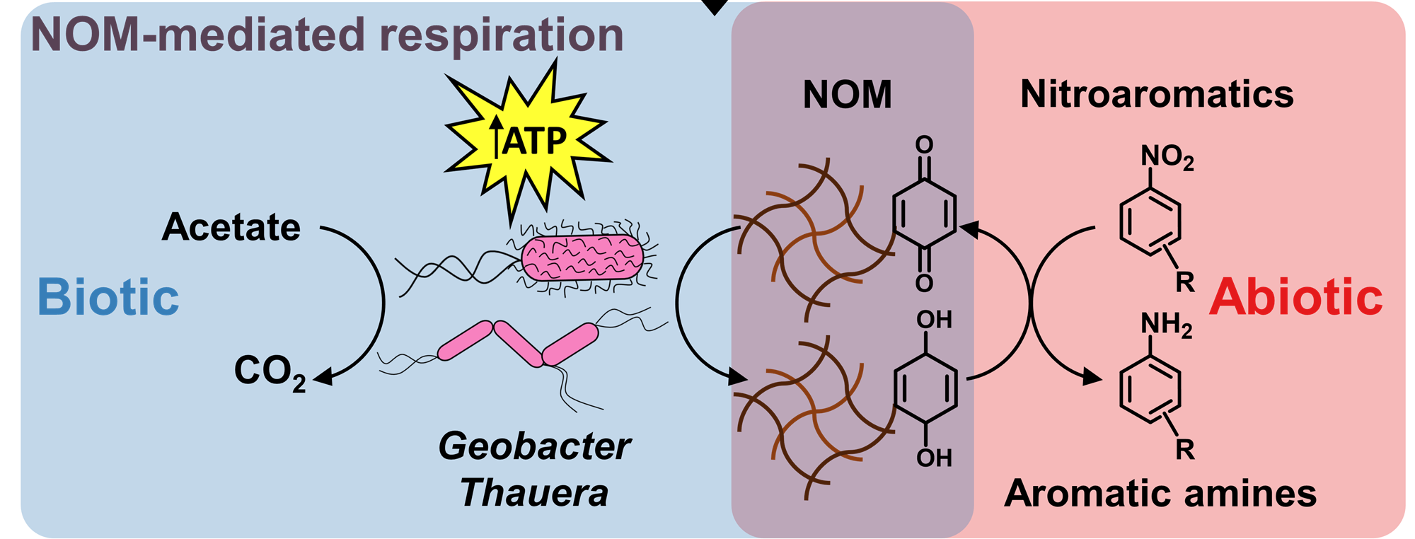
Applying to Natural Organic Matter (NOM)
11
Notes:
Could this apply to natural organic matter ?

Slide 12
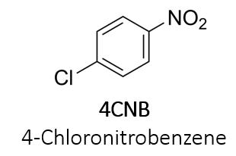
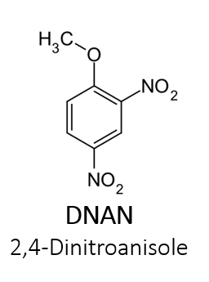
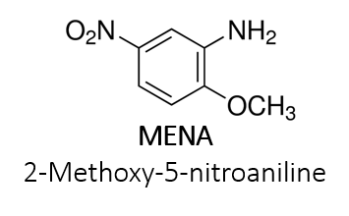
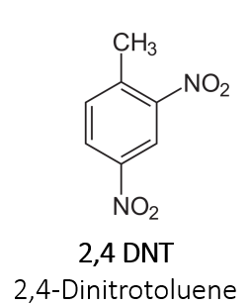
Tested Nitroaromatics
12
Notes:
Here are the nitroaromatics we tested for the overall process

Slide 13
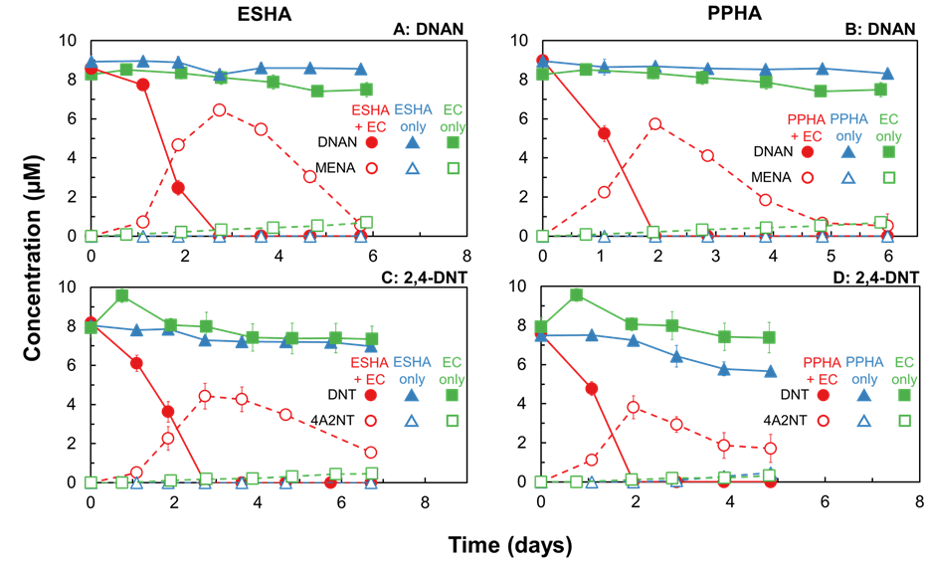
Experimentally using NOM for reduction
13
Notes:
Yes it can!

Slide 14
Take home messages
14
Quinone moieties in natural organic matter (NOM)
  Can act as catalysts for reducing nitroaromatic compounds
Geobacter anodireducens in NOM
  Can act as electron messenger when oxidizing acetate and reducing AQDS
Potential for environmental application of this process if requirements are met

Slide 15

Acknowledgments
15
Reyes Sierra-Alvarez
The entire Field-Sierra research group
Osmar Menezes

Slide 16
References
16
Osmar Menezes ª, ‡, Kumru Kocaman ^{b}, ‡, Stanley Wong ª, Erika E. Rios-Valenciana ª, Eliot J. Baker ª, Janet K. Hatt ^{b}, Jianshu Zhao ^{c}, Camila L. Madeira ª, Mark J. Krzmarzick ^{d}, Jim C. Spain ^{b, e}, Reyes Sierra-Alvarez ª, Kostas T. Konstantinidis b, Jim A. Field ^{a,.} “Quinone Moieties of Natural Organic Matter Expand the Substrate Spectrum of Microbial Nitroaromatic Respiration”. March 2022.
Menezes, Osmar. “Understanding how soil natural organic matter helps microbes to breathe explosives (and other nitroaromatics). Seminar. University of Arizona Department of Chemical and Environmental Engineering. Field-Sierra Research Group. March 2022.

Slide 17
17
Thank you

